Slide 1
Denoising and Interpolation with BM3D
Joe Driscoll

Slide 2
Introduction
Fundamental problems of denoising and interpolation
Denoising
Wiener filters (lack of priors)
Filters with different objectives
BM3D and variants (considered among best)
Interpolation/Upsampling
Given data points, predict in-between values
Bilinear, bicubic, higher order, etc.
Dictionary learning (ANR, A+)
Surprising application of (C)BM3D (bonus denoising)

Slide 3
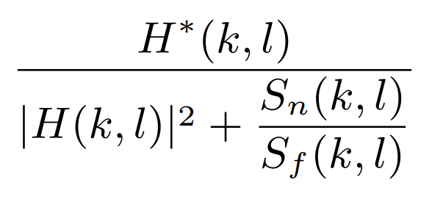
Overview of BM3D
Block Matching and 3D filtering
Two stages - first gives second a Wiener filter
First stage
Find similar patches in image
Stack patches, transform, and threshold
Place patches with transform coefficient weighting (and Kaiser)
Second stage
Find similar patches from first stage estimate
Make separate stacks for denoised and noisy
Use denoised stacks to generate Wiener filter
Filter noisy stacks with Wiener filter
Combine patches back into image
Weights based on squared, 2-norm of Wiener filter weights (and Kaiser)
Variants
CBM3D (color version of BM3D)
BM3D-SAPCA
Neural network architectures based on BM3D scheme

Slide 4
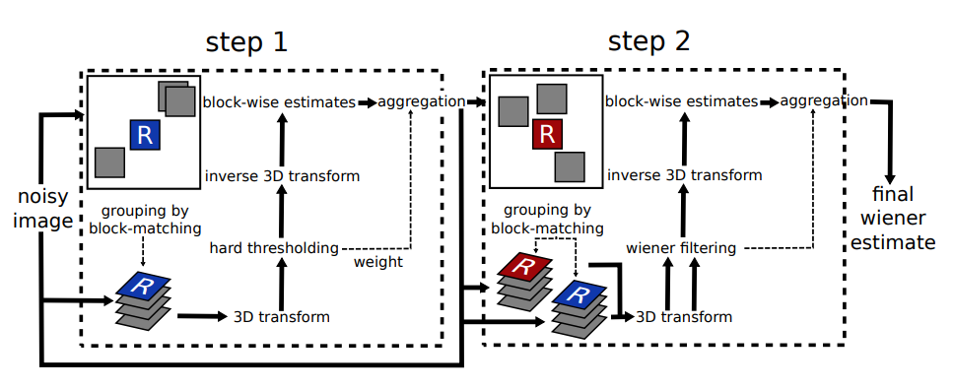
BM3D Diagram [1]

Slide 5
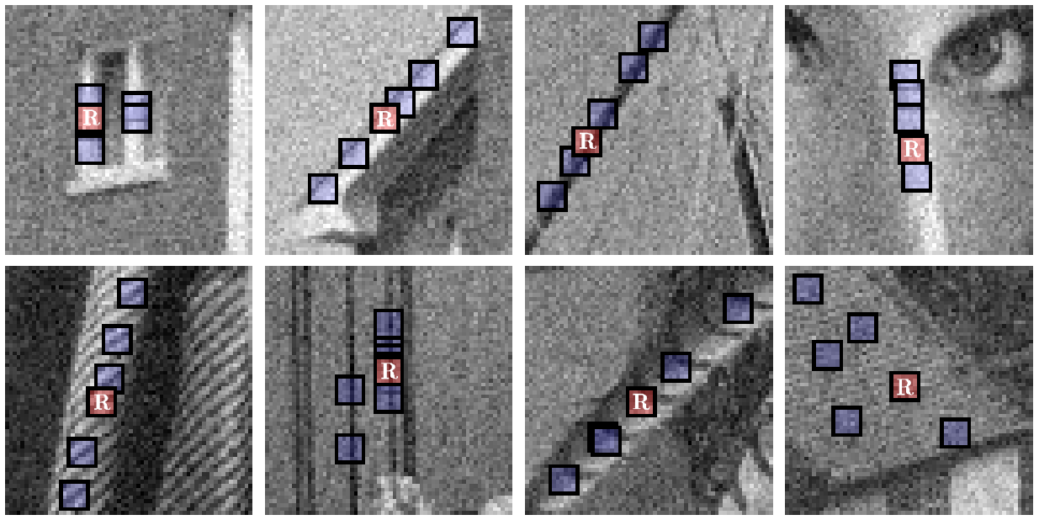
Block Matching Example [2]

Slide 6
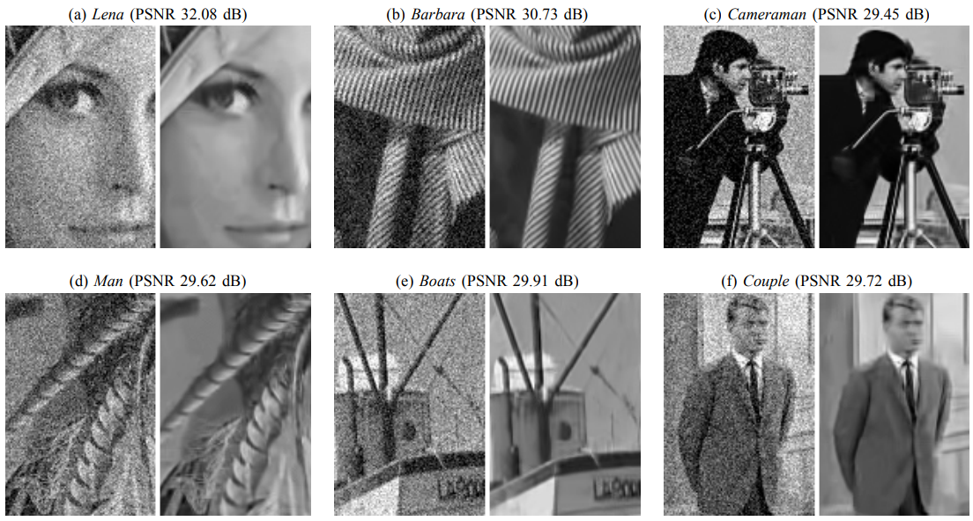
Results from Original BM3D Paper [2]

Slide 7
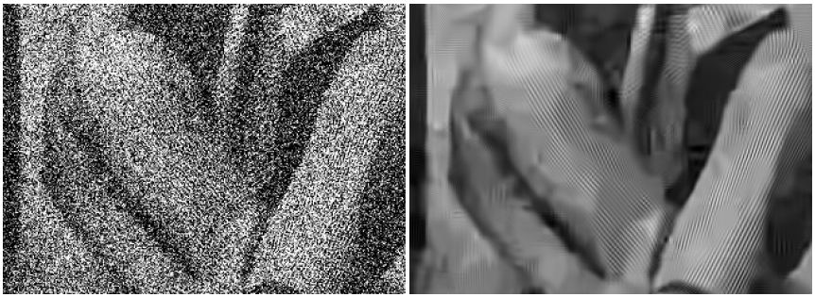
Results from Original BM3D Paper [2]
PSNR: 8.14 dB
PSNR: 23.49 dB

Slide 8
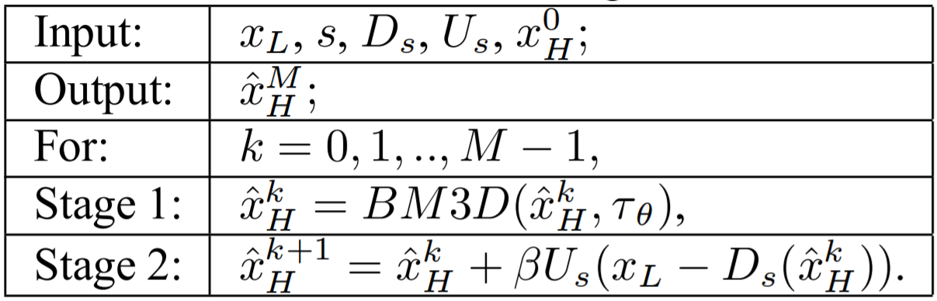
CBM3D Interpolation (SR_CBM3D)
CBM3D – color extension
Used for upsampling – [3]
Iterative algorithm
Iteratively denoise and correct
Upsampled image should be similar to original
Optimality proven under assumptions in [3]

Slide 9
Experimental Procedure
Begin with a test image
Downsample and add noise
Upsample with bicubic and SR_BM3D
Compare performance
PSNR
SSIM
Visual appeal
Upsample test image and analyze visually
One example shown next

Slide 10
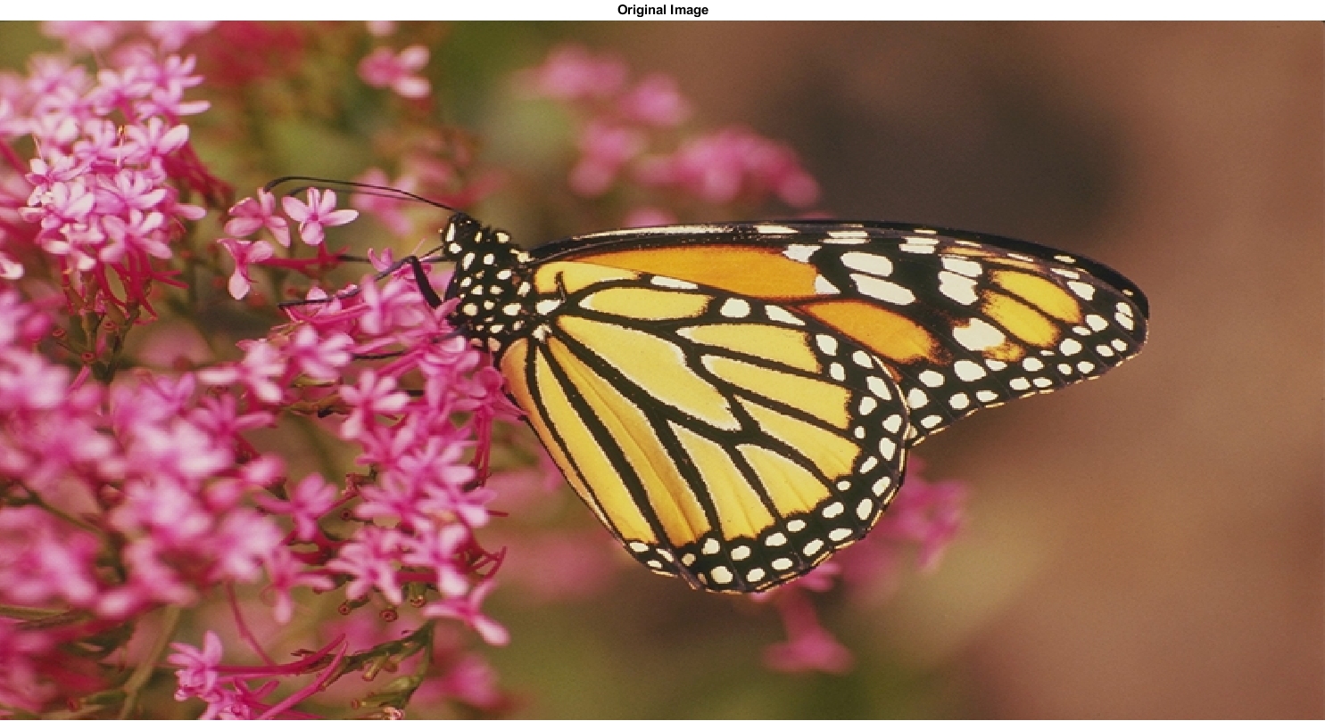
Monarch Test Image

Slide 11
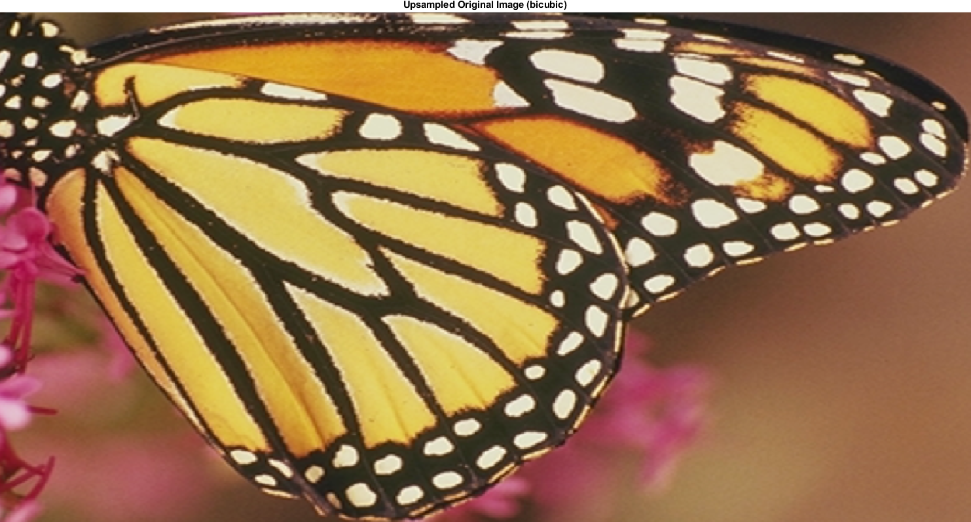
Bicubic Upsampling of Original (Zoomed)

Slide 12
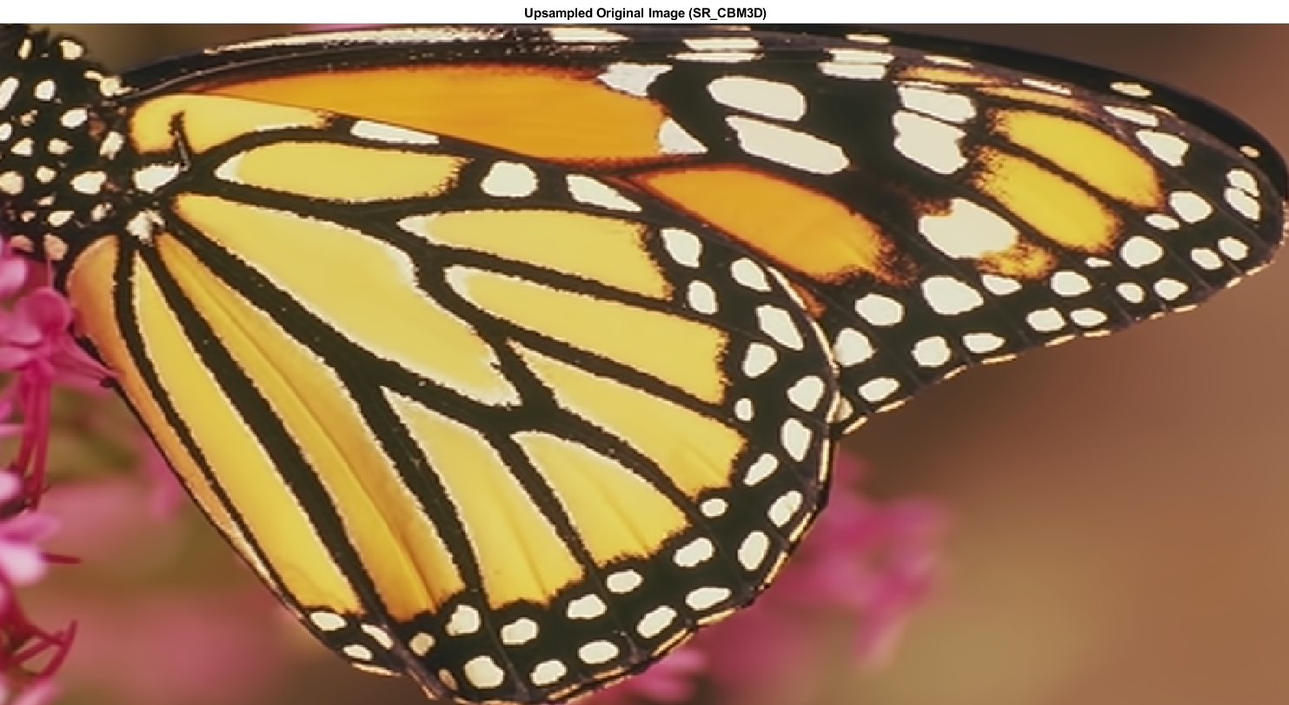
SR_CBM3D Upsampling of Original (Zoomed)

Slide 13
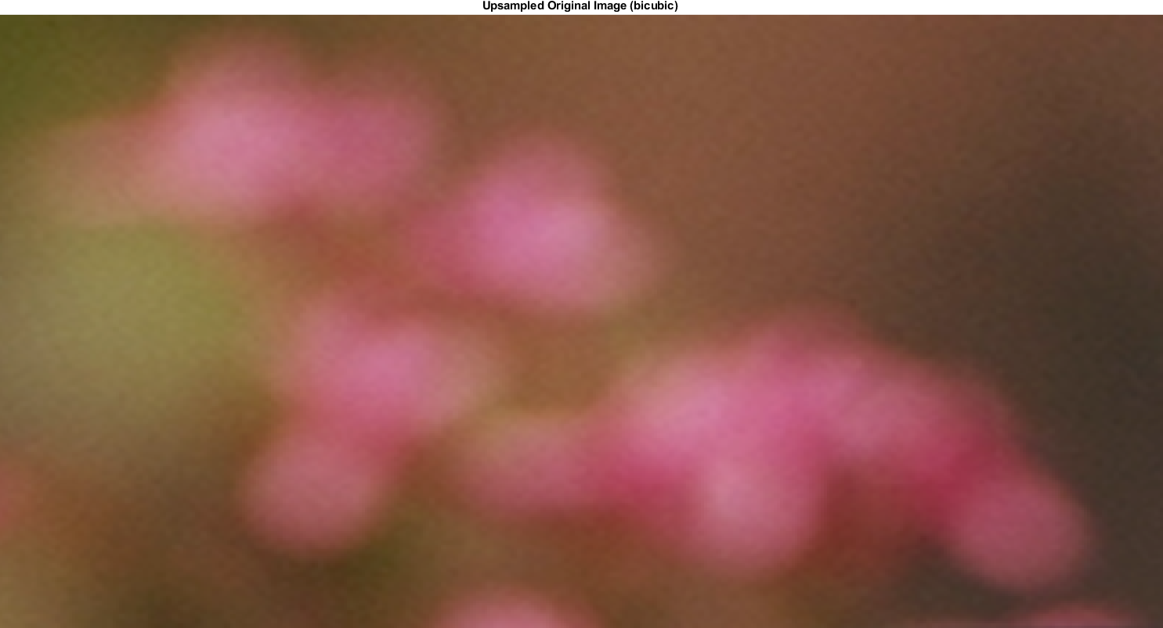
Bicubic Upsampling of Original (Zoomed)

Slide 14

SR_CBM3D Upsampling of Original (Zoomed)

Slide 15
Monarch Test Image

Slide 16
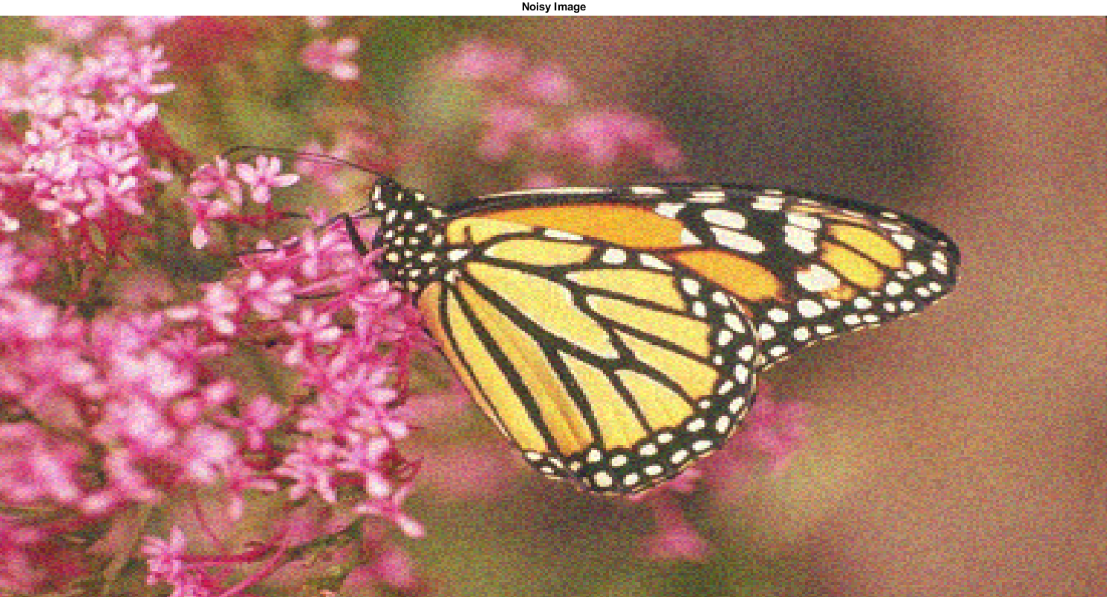
Noisy, Downsampled Image

Slide 17
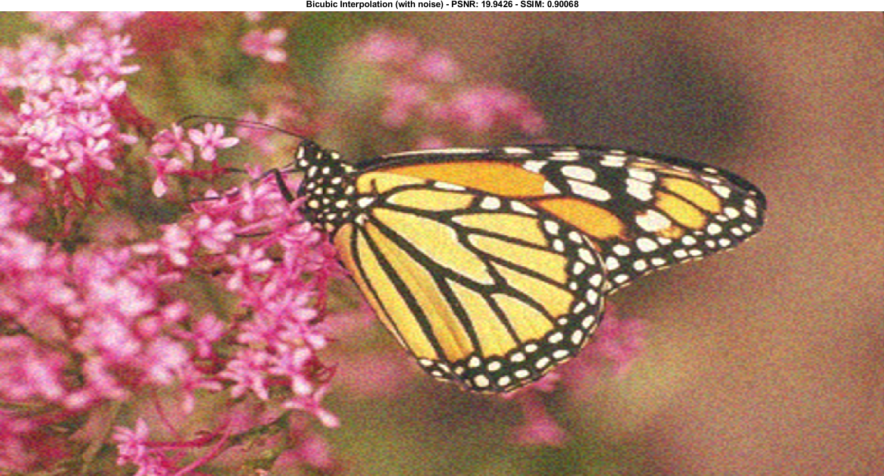
Bicubic Interpolation – PSNR: 19.94 dB – SSIM: 0.907

Slide 18

SR_CBM3D Interpolation – PSNR: 20.61 dB – SSIM: 0.955

Slide 19
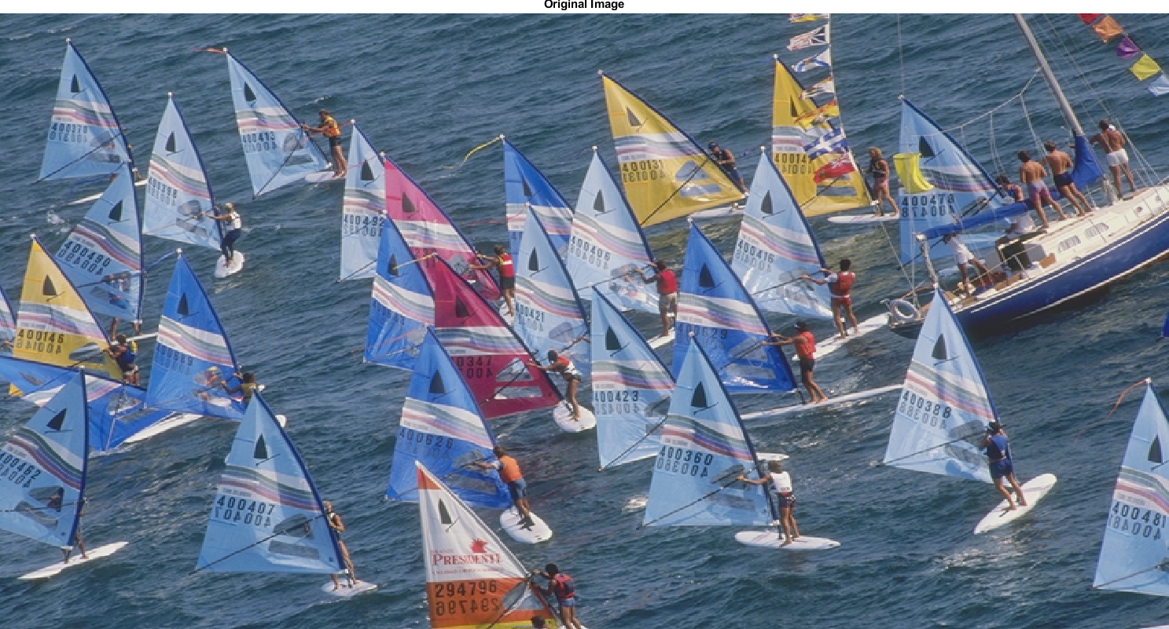
Original Image

Slide 20
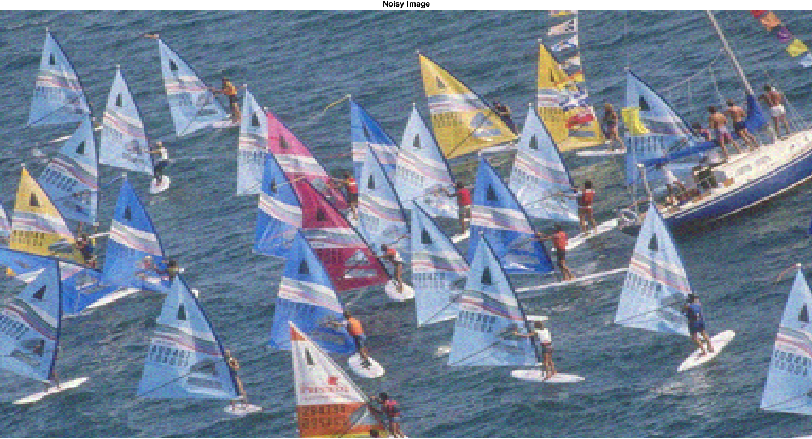
Noisy, Downsampled Image

Slide 21
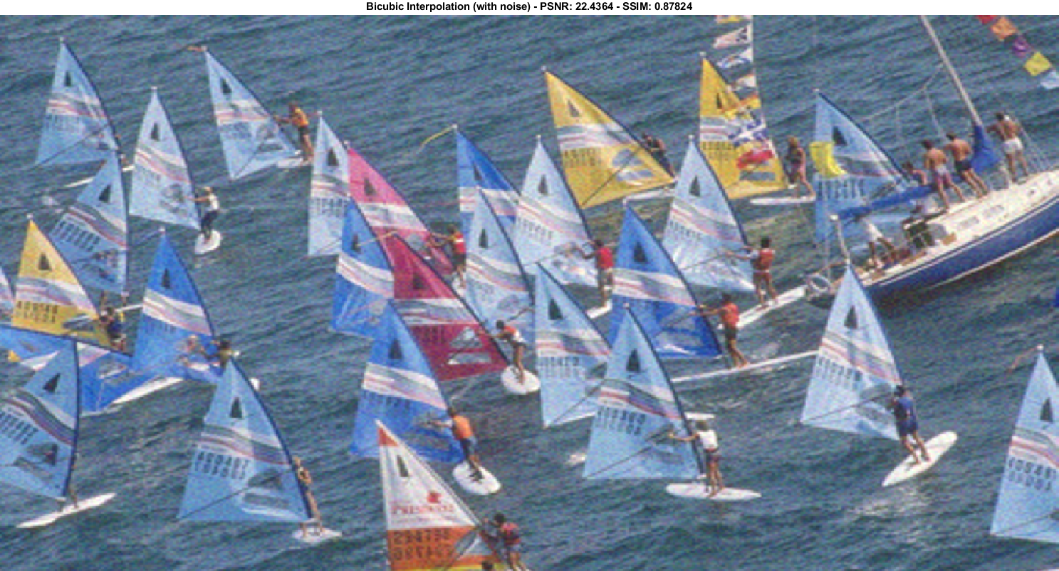
Bicubic Interpolation – PSNR: 22.44 dB – SSIM: 0.878

Slide 22

SR_CBM3D Interpolation – PSNR: 23.03 dB – SSIM: 0.915

Slide 23
References
[1] Marc Lebrun. An analysis and implementation of thebm3d image denoising method. Image Processing On Line, 2012. https://github.com/jwd0023/ELEC_7450/blob/master/papers/lebrun_bm3d_analysis.pdf.
[2] Dabov et al. Image denoising by sparse 3d transform-domain collaborative filtering. IEEE Transactions on Image Process-ing, 2007. https://github.com/jwd0023/ELEC_7450/blob/master/papers/bm3d_2007_conference_original.pdf.
[3] Karen Egiazarian and Vladimir Katkovnik. Single image super-resolution via bm3d sparse coding. EUSIPCO, 2015. https://github.com/jwd0023/ELEC_7450/blob/master/papers/egiazarian_image_upsampling.pdf
[4] Danielyan et al. Image upsampling via spatially adaptive block-matching filtering. EUSIPCO, 2008. https://github.com/jwd0023/ELEC_7450/blob/master/papers/egiazarian_image_upsampling.pdf.
[5] Dabov et al. Bm3d image denoising with shape-adaptive princi-pal component analysis. https://github.com/jwd0023/ELEC_7450/blob/master/papers/dabov_bm3d_pca.pdf, 2009.

Slide 24
Questions?

Slide 25
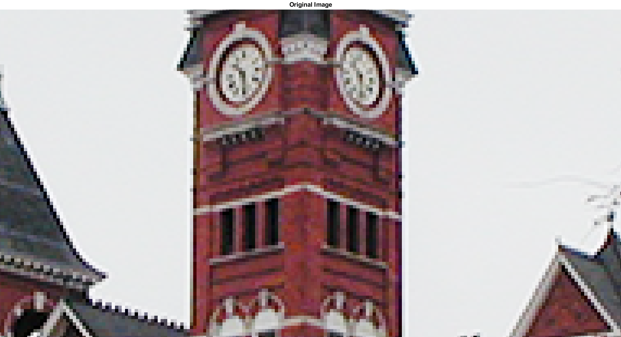
Samford Clock (Original)

Slide 26

Samford Clock (Bicubic Interpolation)

Slide 27
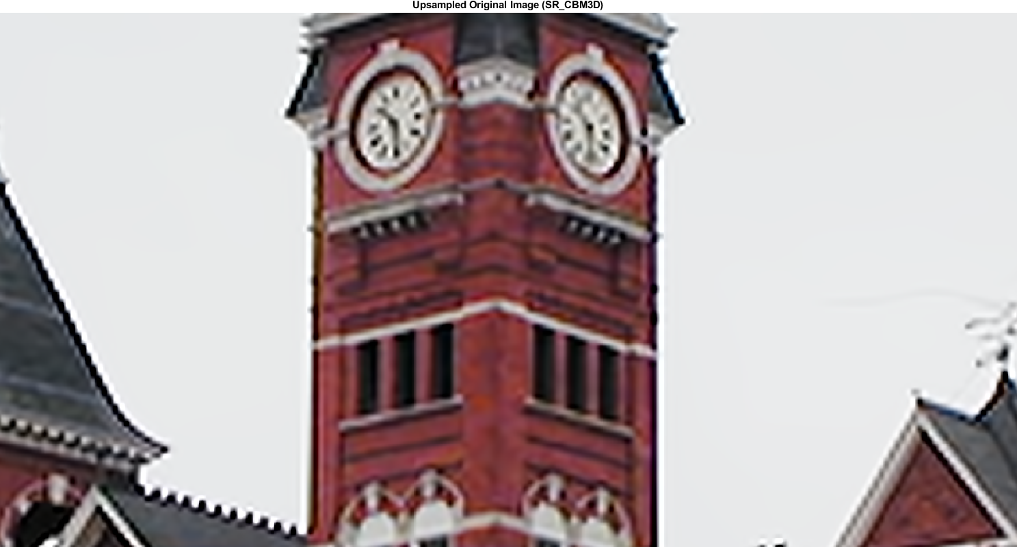
Samford Clock (SR_CBM3D Interpolation)

